Slide 1


K.RAMAKRISHNAN COLLEGE OF TECHNOLOGY
(AUTONOMOUS), TRICHY.
VEHICLE MAINTENANCE SYSTEM
PRESENTED
VIJAYA PRAKASH
2303811710421176
SUPERVISOR
Mr.A.Malarmannan, M.E., AP/CSE.

Slide 2
PRESENTATION OVERVIEW
Objective
Project Introduction
Problem Statement
Methodologies (Programming concepts relevant to problem statement)
Architecture of the proposed system
List of Modules
Merits
Results and Discussion
Queries

Slide 3
OBJECTIVE
The objective of a Vehicle Maintenance System is to efficiently manage and streamline all aspects of vehicle maintenance. It aims to track maintenance schedules, store detailed service history, and send timely alerts for upcoming tasks to ensure vehicles remain in optimal condition
The system helps reduce downtime by addressing issues proactively and minimizing repair costs through regular upkeep. By automating record-keeping and providing performance insights, it enhances vehicle safety, reliability, and operational efficiency.

Slide 4
PROJECT INTRODUCTION
A Vehicle Maintenance System is a software solution designed to simplify and streamline the process of maintaining vehicles. Whether for individual users or businesses managing a fleet, the system ensures vehicles are kept in optimal condition by tracking maintenance schedules, recording service history, and providing timely reminders for necessary repairs or inspections.
A Vehicle Maintenance System (VMS) is a software application designed to streamline and automate the process of managing vehicle repairs, servicing, and upkeep. It is used by individual vehicle owners, fleet managers, and service providers to ensure vehicles remain in optimal condition, minimizing breakdowns and improving efficiency.

Slide 5
PROBLEM STATEMENT
Managing vehicle maintenance manually can be time-consuming, error-prone, and inefficient, especially for individuals or businesses handling multiple vehicles. Without a proper system, it becomes challenging to track service schedules, monitor performance, and maintain accurate records. This often leads to missed maintenance, increased downtime, higher repair costs, reduced vehicle safety, and shorter lifespan.
.

Slide 6
METHODOLOGIES
1.Requirement Gathering and Analysis
Identify the needs of users and stakeholders by gathering information about desired features, such as maintenance tracking, service history, notifications, and reporting.
2. System Design
Create a blueprint of the system, including the architecture, database schema, and user interface layout. Ensure the design is scalable and user-friendly.
3. Database Development:
Build a database to store and manage vehicle information, maintenance records, user data, and notifications efficiently.
4.Training and Support:
Provide training for users to help them understand the system’s features. Offer ongoing technical support for troubleshooting.

Slide 7
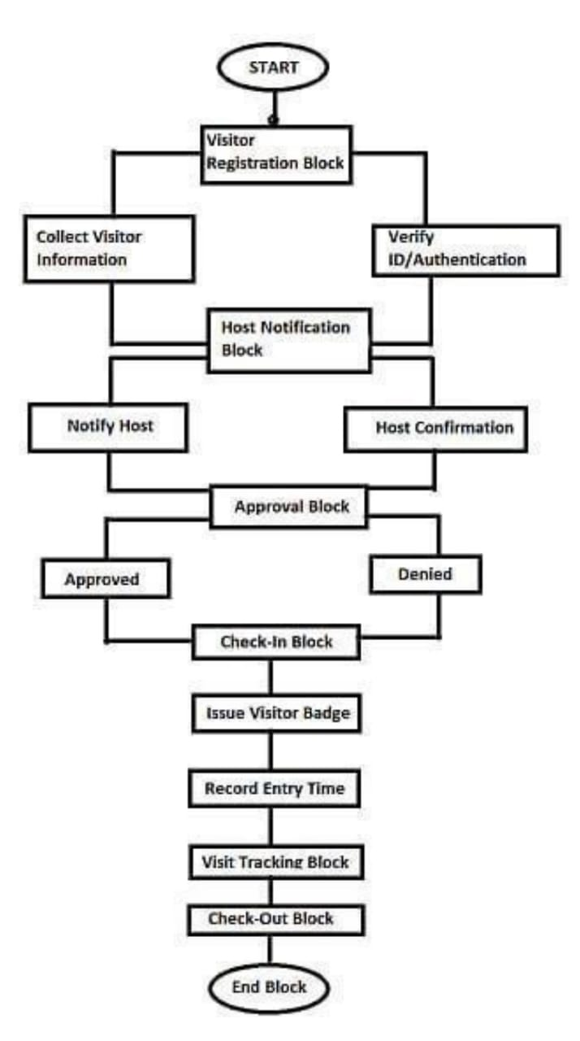
ARCHITECTURE OF THE PROPOSED SYSTEM

Slide 8
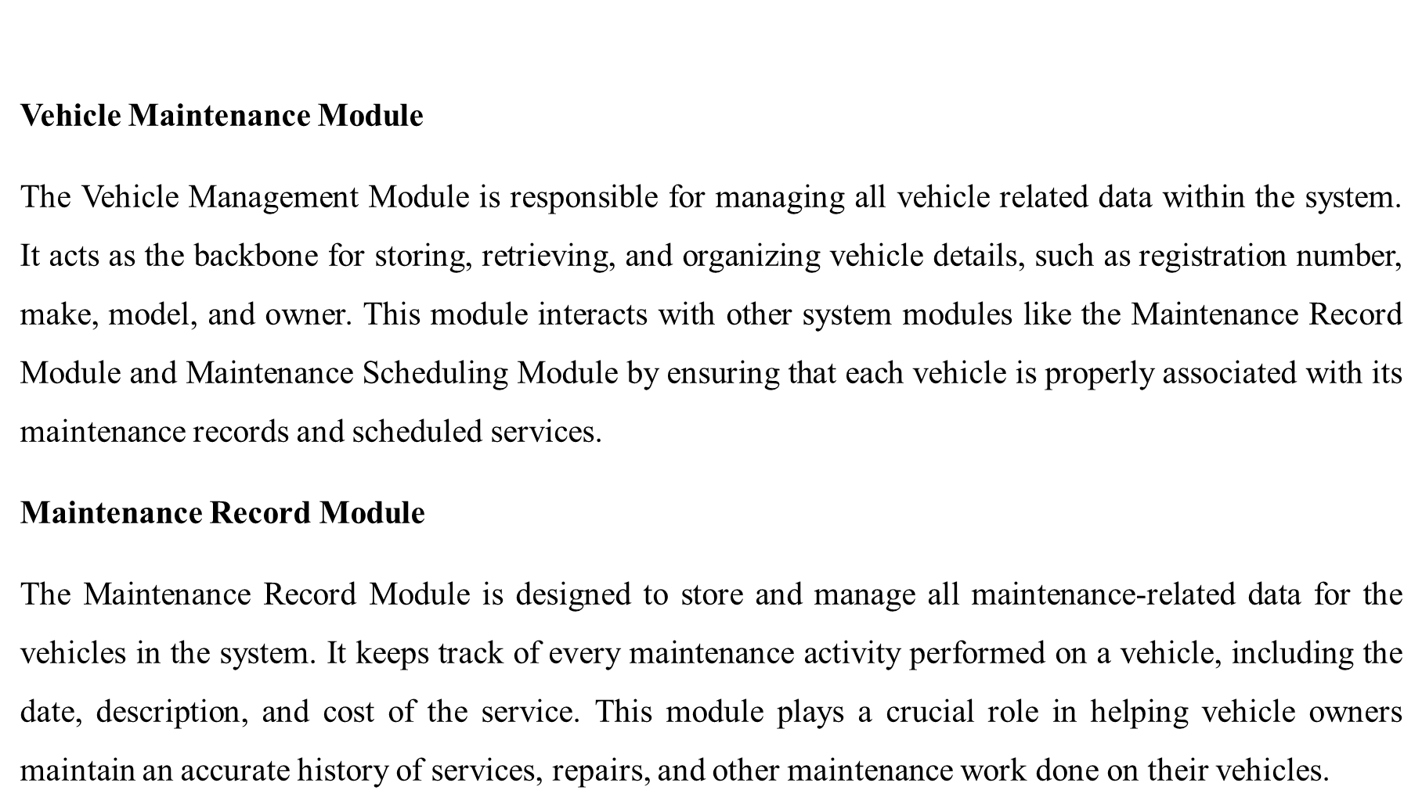
LIST OF MODULES

Slide 9
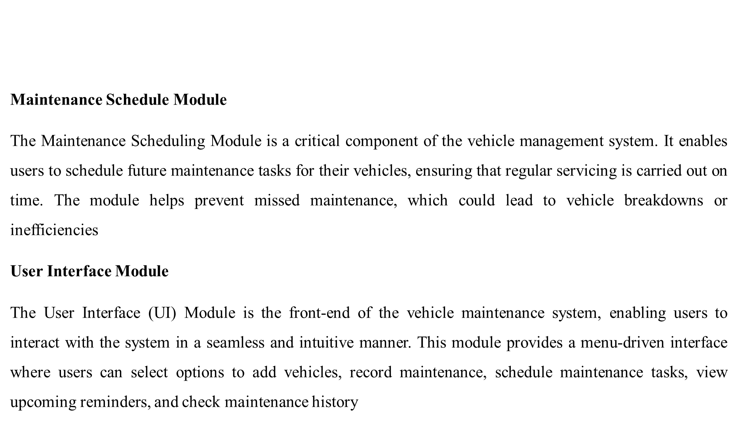
LIST OF MODULES

Slide 10
MERITS
Platform Independence: capability ensures the system can run on any platform with a Java Virtual Machine making suitable for diverse environments such as desktop, mobile, and server applications.
Scalability: Its support for multithreading and distributed computing enables handling of large data volumes and concurrent tasks.
Maintainability: Modular design using object-oriented principles (inheritance, encapsulation, polymorphism) enhances code readability and reusability, simplifying maintenance and upgrades.
Cost-Effectiveness: Open-source nature of Java and its ecosystem reduces licensing and development costs. Compatibility with free and widely-used tools and frameworks further lowers the overall expenditure.
Security: Built-in encryption and secure communication libraries. Role-based access controls for sensitive data. Protection against common vulnerabilities like memory leaks and buffer overflows.

Slide 11
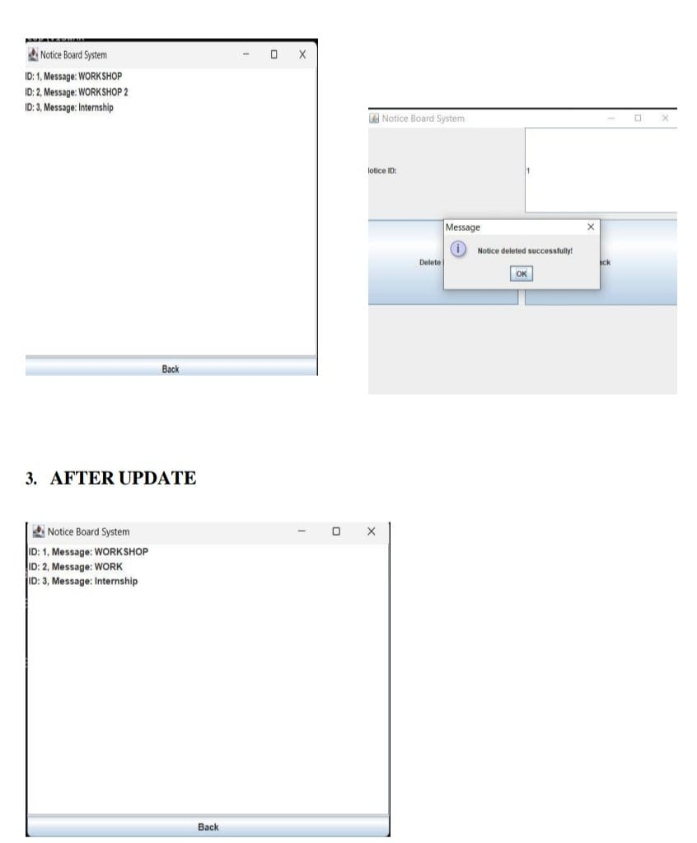
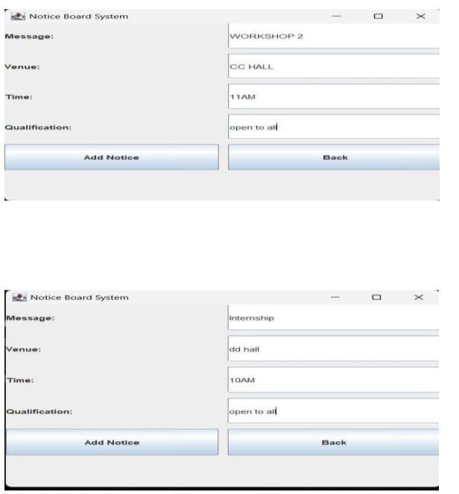
RESULTS AND DISCUSSION

Slide 12
QUERIES ?

